Slide 1

CIS 404 Capstone Project
Presented by Jerry C

Slide 2
Table of contents
01
Project Outline
02
SDLC Implementation
03
Project Management: Jira
04
Design Algorithm & Demo

Slide 3
Project Outline
Breakout Ball Game
Java
Features
Graphics
Basic paddle and ball mechanics for breaking bricks
Simple 2D graphics with basic shapes (rectangles, circles)
AWT and Swing for graphics and event handling
Score tracking
Use of colors to differentiate the paddle, ball, and bricks
Game over and victory conditions

Slide 4
SDLC Implementation
SDLC
Software Development Life Cycle
Maintenance
M
P
Planning
Error correction and database update
Objective Definition and feasibility study
Testing
T
A
Analysis
Unit and performance testing
Requirement Gathering and resource allocation
Implementation
I
D
Design
Develop the system using Java
Architecture and UI/UX Design

Slide 5
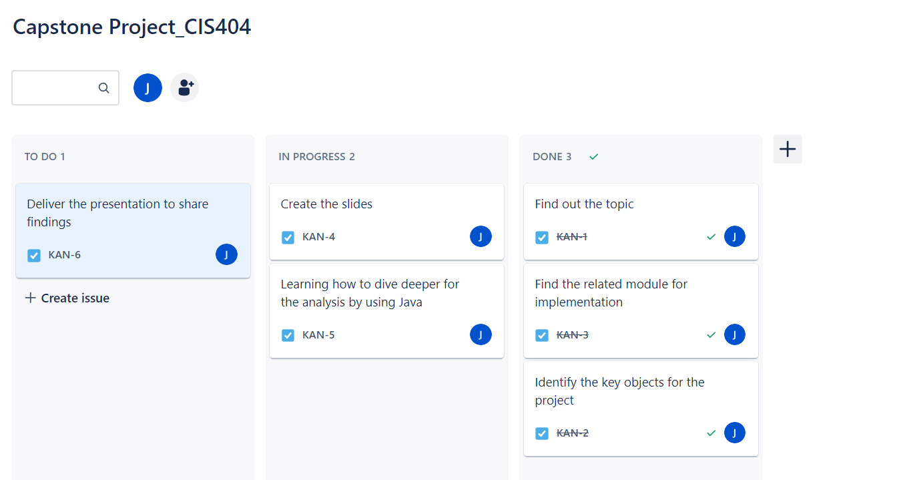
Project Management: Jira

Slide 6
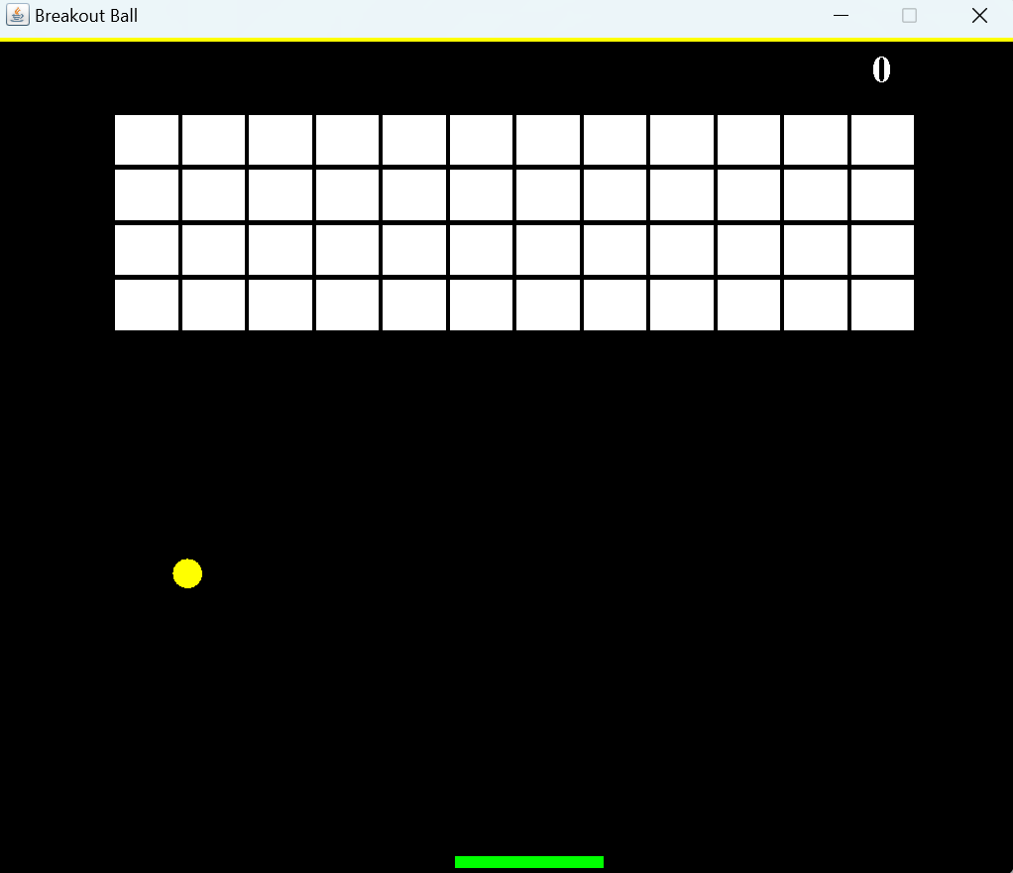
Design Algorithm & Demo

Slide 7
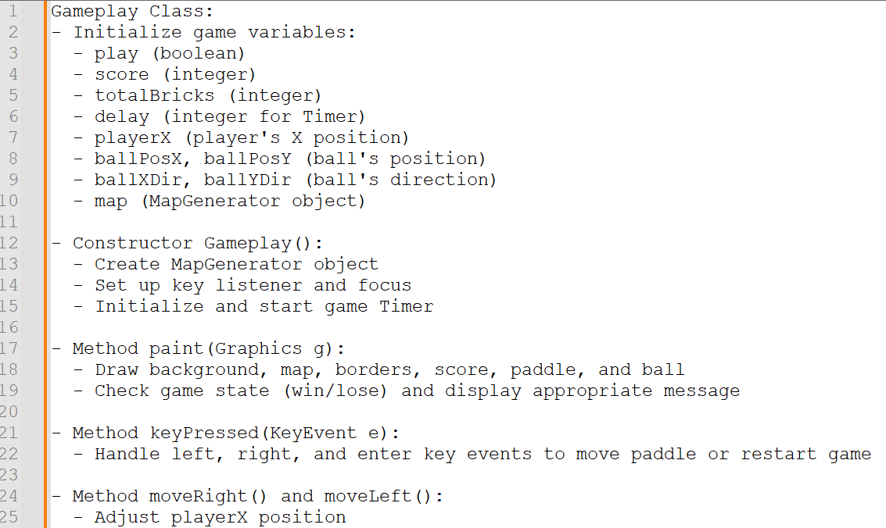
Design Algorithm

Slide 8
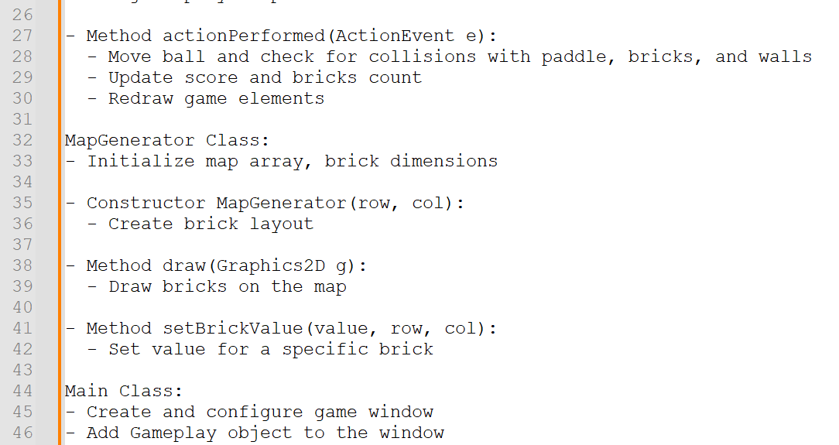
Design Algorithm

Slide 9


Slide 10
Thank you :)

